Slide 1

Lesson no 3
Information Warfare

Slide 2
01. Command and Control Warfare
02. Psychological Operations (PSYOPS)
03. Military Deception (MILDEC)
CONTENTS
04. Security Operations (OPSEC)
05. Physical Destruction
06. Electronic Warfare (EW)

Slide 3
01. Command and Control Warfare

Slide 4
Information warfare includes actions taken to:
preserve the integrity of one’s own information system from exploitation, corruption, or disruption,
while at the same time exploiting, corrupting, or destroying an adversary’s information system,
as well as the process of achieving an information advantage in the application of force.

Slide 5
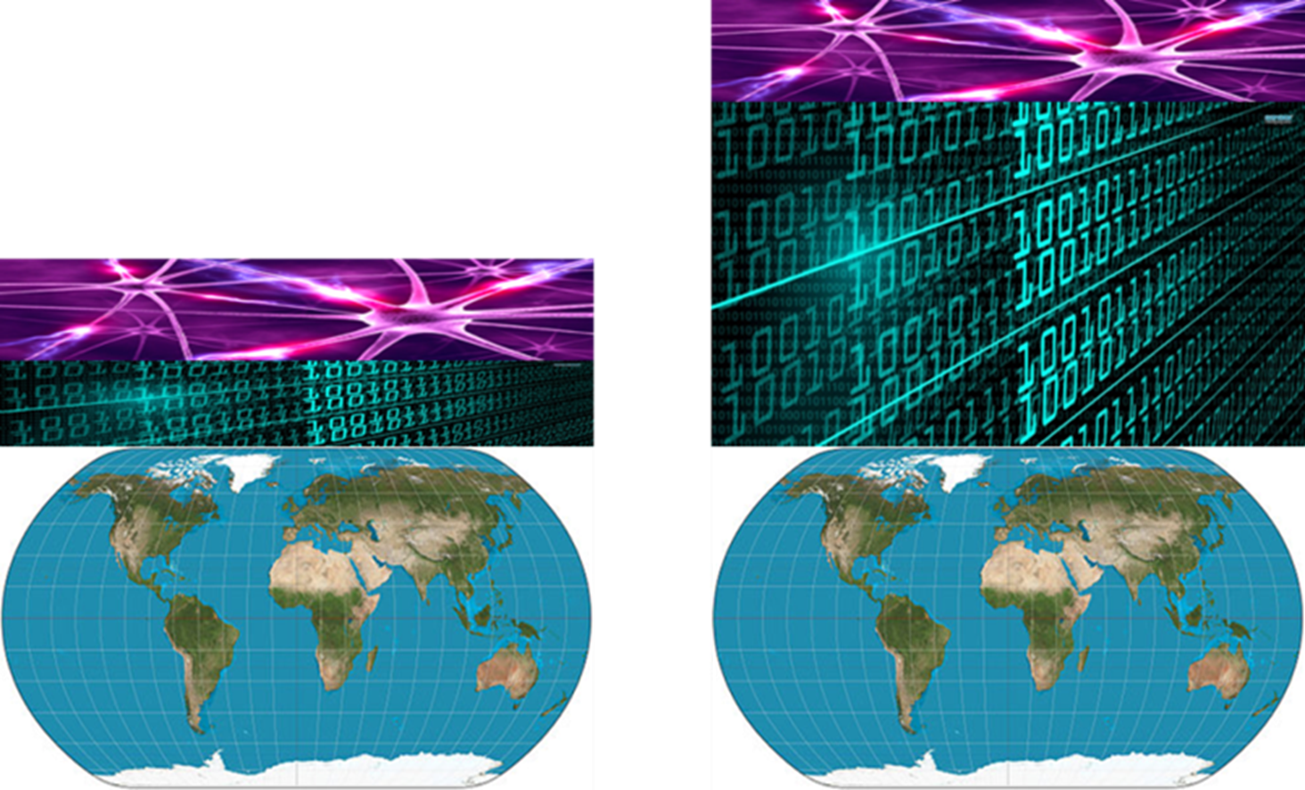

Slide 6
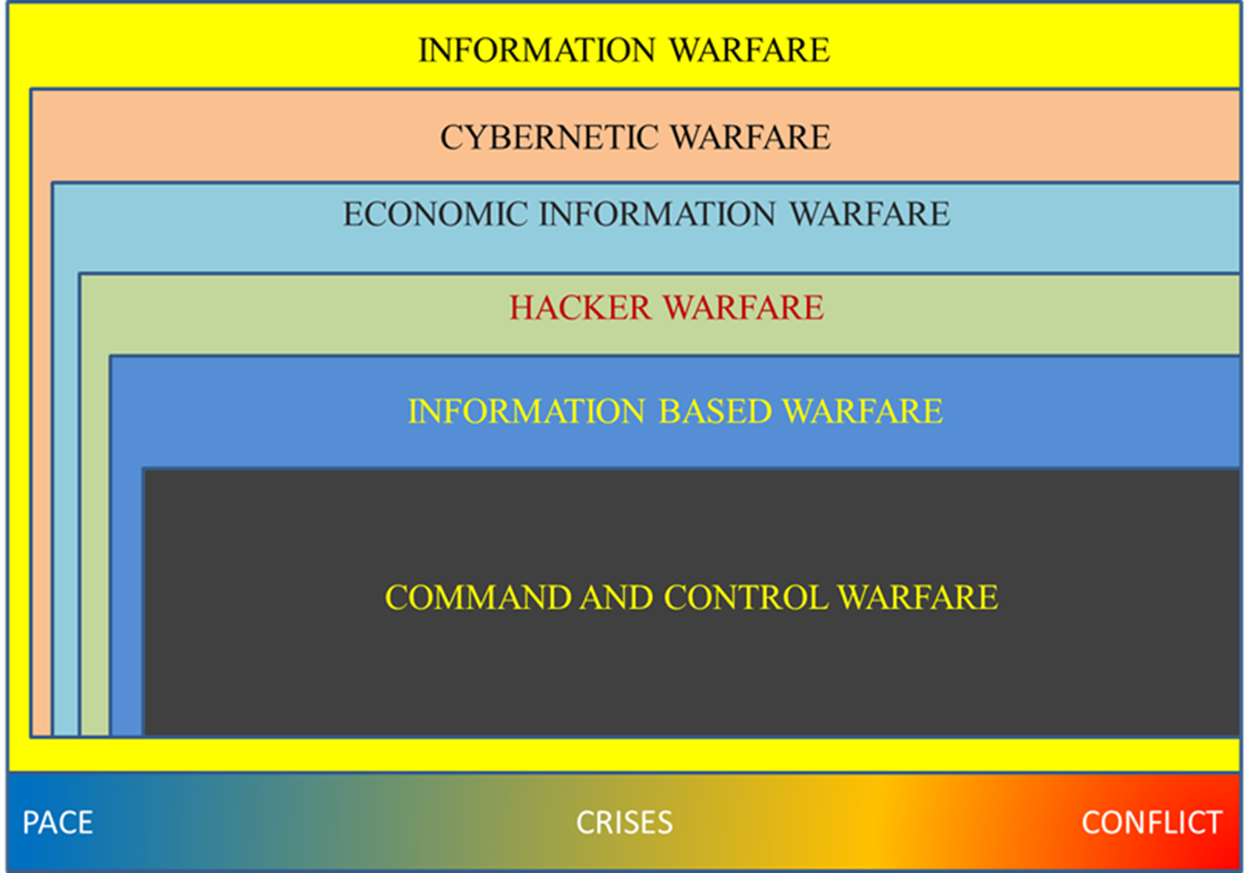

Slide 7
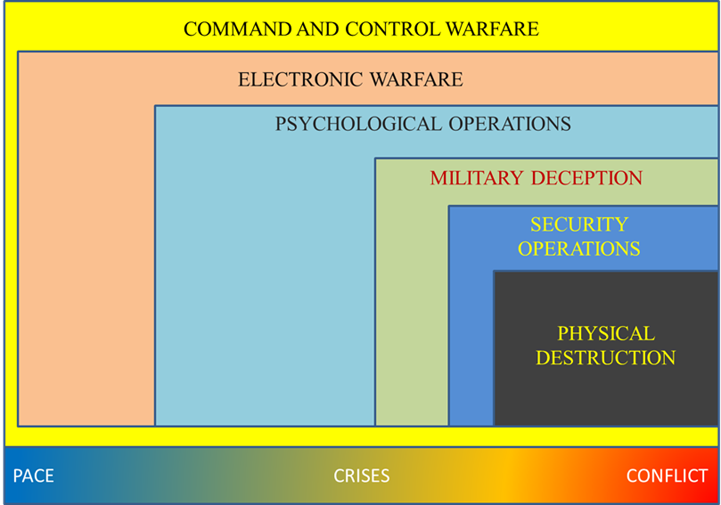

Slide 8
02. Psychological Operations (PSYOPS)

Slide 9
Psychological Operations (PSYOPS) – represents all actions taken to emotionally influence the enemy at political, military, economical and information level to support own operations;

Slide 10
Types of PSYOPS
Cohesive
Divisive

Slide 11
Cohesive PSYOPS
Develops national unity
Promotes favorable government images
Provides public information
Improves civil-military relations
Counters hostile propaganda
Unites audience against common foe

Slide 12
Divisive PSYOPS
Exploits vulnerabilities & failures
Encourages dissension
Weakens opposition
Exploits intolerance
Encourages defection and inaction (apathy)
Emphasizes self-interest

Slide 13
Why use PSYOPS?
Low cost/High impact
Force multiplier in aerospace Information Operations
Leverages Technological advances
Conserves forces

Slide 14
03. Military Deception (MILDEC)

Slide 15
Military Deception (MILDEC) – represents all actions undertaken to determine the enemy to estimate incorrectly the operational status so as to expose to vulnerabilities and engagement of new forces in our desired direction;

Slide 16
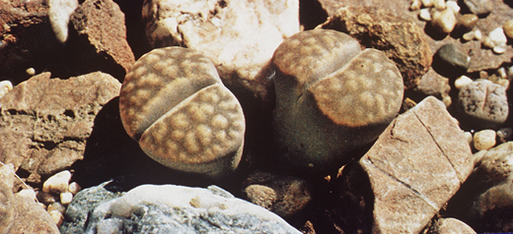
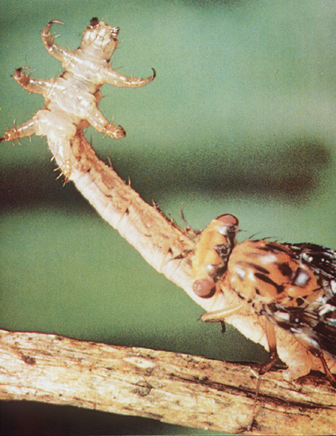


Deception in Nature

Slide 17
Deception’s Primary Goal
Support the Commander’s mission and concept of operations
  Cause adversary to incorrectly employ forces
  Cause adversary to reveal strengths, weaknesses, dispositions and future intentions
  Overload adversary intelligence and analysis capability
  Condition adversary to patterns that can be exploited
  Cause adversary to waste combat power
(Cause the adversary to lose)

Slide 18
04. Security Operations (OPSEC)

Slide 19
Security Operations (OPSEC) – represents all actions taken to prevent the enemy to obtain the information necessary for an accurate estimation of the operational situation;

Slide 20
Unique Characteristic
OPSEC is a PROCESS
1
2
3
4
5
OPSEC is NOT
a set of Rules

Slide 21
The Differences
Traditional Security
OPSEC
Most information is classified
Usually, unclassified
Addresses the general threat
Addresses specific adversaries
Risk applies to all situations
Risk decisions are event specific
Directed by security regulations
Directed by operational component command
Countermeasures established
Countermeasures often unique

Slide 22
Five Step OPSEC Process
Identify Critical Information
Determine Threat
Analyze Vulnerabilities
Assess Risk
Apply appropriate OPSEC Measures
1
2
3
4
5

Slide 23
05. Physical Destruction

Slide 24
Physical Destruction – represents all actions taken to control the destruction of enemy command and control systems in order to achieve the objectives of command-and-control war.

Slide 25
Potential IW Targets
HQs:
  Intel, Component Forces, Field & Naval HQs
IADS:
  HQs, Sector Operations Centers, Radars, EW, SAMS
Communications: All
SIGINT: All

Slide 26
06. Electronic Warfare (EW)

Slide 27
Electronic Warfare (EW) – the military action involving the use of electromagnetic (EM) or directed energy (DE) to control the electromagnetic spectrum (EMS) or to attack the enemy.

Slide 28
Electronic Support (ES)
Electronic Attack (EA)
Electronic Defense (ED)

Slide 29
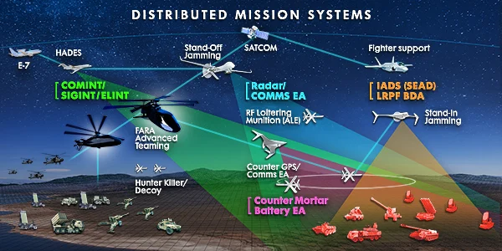

Slide 30
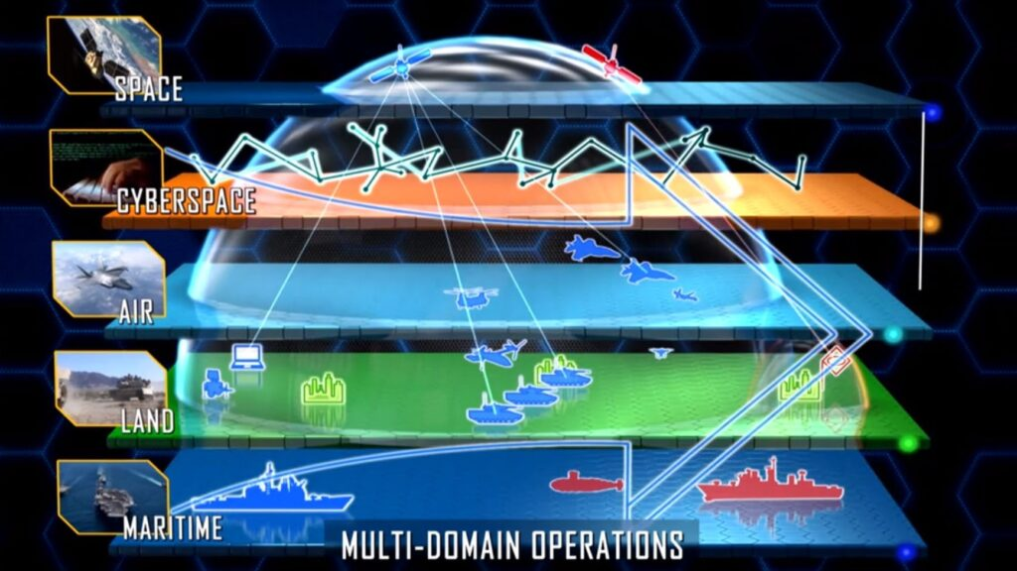

Slide 31
Cyberspace
Space
Air
Maritim
Land

Slide 32
Thanks

